Slide 1
Software Testing
What ?
Why ?
Verification and Validation
Defects, Bug, Failure, Error

Slide 2
How many errors are still remaining?
Seed the code with some known errors:
  artificial errors are introduced into the program.
  Check how many of the seeded errors are detected during testing.

Slide 3
Error Seeding
Let:
  N be the total number of errors in the system
  n of these errors be found by testing.
  S be the total number of seeded errors,
  s of the seeded errors be found during testing.

Slide 4
Error Seeding
n/N = s/S
N = S n/s
remaining defects:
N - n = n ((S - s)/ s)

Slide 5
Example
100 errors were introduced.
90 of these errors were found during testing
50 other errors were also found.
Remaining errors=
N - n = n ((S - s)/ s)
=50 (100-90)/90 = 6

Slide 6
Error Seeding
The kind of seeded errors should match closely with existing errors:
  However, it is difficult to predict the types of errors that exist.
Categories of remaining errors:
  can be estimated by analyzing historical data from similar projects.

Slide 7
Question
Which of the following is not part of the Test type ?
Functional Testing
Statement Testing
Unit Testing
System Testing

Slide 8
Black-box Testing
Test cases are designed using only functional specification of the software:
  without any knowledge of the internal structure of the software.
For this reason, black-box testing is also known as functional testing.

Slide 9
White-box Testing
Designing white-box test cases:
  requires knowledge about the internal structure of software.
  white-box testing is also called structural testing.

Slide 10
Black-box Testing
Two main approaches to design black box test cases:
  Equivalence class partitioning
  Boundary value analysis

Slide 11
Q) True or false? Generally, in practice, developers exhaustively test software.
a. True
b. False

Slide 12
White-Box Testing
There exist several popular white-box testing methodologies:
  Statement coverage
  branch coverage
  path coverage
  condition coverage
  mutation testing
  data flow-based testing

Slide 13
Statement Coverage
Statement coverage methodology:
  design test cases so that
    every statement in a program is executed at least once.

Slide 14
Statement Coverage
The principal idea:
  unless a statement is executed,
  we have no way of knowing if an error exists in that statement.

Slide 15
Example
int f1(int x, int y){
1 while (x != y){
2 if (x>y) then
3 x=x-y;
4 else y=y-x;
5 }
6 return x; }
Test suite is: (3,3), (4,3) and (3,4) which will do 100% statement coverage
Euclid's GCD Algorithm

Slide 16
Example
print (int a, int b) {
int sum = a+b;
if (sum>0)
print (“Output")
else
print (“Output")
}
Test Cases ..?

Slide 17
Branch Coverage
Test cases are designed such that:
  different branch conditions
    given true and false values in turn.

Slide 18
Branch Coverage
Branch testing guarantees statement coverage:
  a stronger testing compared to the statement coverage-based testing.

Slide 19
Example
int f1(int x,int y){
1 while (x != y){
2 if (x>y) then
3 x=x-y;
4 else y=y-x;
5 }
6 return x; }

Slide 20
Example
Test cases for branch coverage can be:
{(x=3,y=3),(x=3,y=2), (x=4,y=3), (x=3,y=4)}

Slide 21
Question
Which are the following statements are true
Black box Testing is based on the external specification of the system
White box Testing is based on the internal structure and logic of the system
White box Testing can do without knowledge of how the system is constructed
Both a and b

Slide 22
Condition Coverage
Test cases are designed such that:
  each component of a composite conditional expression
    given both true and false values.

Slide 23
Example
Consider the conditional expression
  ((c1.and.c2).or.c3):
Each of c1, c2, and c3 are exercised at least once,
  i.e. given true and false values.

Slide 24
Condition coverage
Consider a boolean expression having n components:
  for condition coverage we require 2^{n} test cases. (n is no. of condtions)

Slide 25
Condition Coverage
2 Condition
T T
T F
F F
F T
3 Condition
TTT
TTF
TFF
FFF
FFT
FTT
TFT
FTF

Slide 26
Path Coverage
Design test cases such that:
  all linearly independent paths in the program are executed at least once.

Slide 27
Linearly independent paths
Defined in terms of
  control flow graph (CFG) of a program.

Slide 28
Path coverage-based testing
To understand the path coverage-based testing:
  we need to learn how to draw control flow graph of a program.

Slide 29
Control flow graph (CFG)
A control flow graph (CFG) describes:
  the sequence in which different instructions of a program get executed.
  the way control flows through the program.

Slide 30
How to draw Control flow graph?
Number all the statements of a program.
Numbered statements:
  represent nodes of the control flow graph.

Slide 31
How to draw Control flow graph?
Sequence:
  1 a=5; b=2;
  2 b=a*b-1;
1
2

Slide 32
How to draw Control flow graph?
Selection:
  1 if(a>b) then
  2 c=3;
  3 else c=5;
  4 c=c*c;
1
2
3
4

Slide 33
How to draw Control flow graph?
1
Iteration:
  1 while(a>b){
  2 b=b*a;
  3 b=b-1;}
  4 c=b+d;
2
3
4

Slide 34
Example
int f1(int x,int y){
1 while (x != y){
2 if (x>y) then
3 x=x-y;
4 else y=y-x;
5 }
6 return x; }

Slide 35
Example Control Flow Graph
1
2
3
4
5
6

Slide 36
Path
A path through a program:
  a node and edge sequence from the starting node to a terminal node of the control flow graph.
  There may be several terminal nodes for program.

Slide 37
Independent path
Any path through the program:
  introducing at least one new node:
    that is not included in any other independent paths.

Slide 38
Linear Independent Path
1
2
3
4
5
6
1,2,3,5,1,6
1,2,4,5,1,6
1,6

Slide 39
Independent path
It is straight forward:
  to identify linearly independent paths of simple programs.
For complicated programs:
  it is not so easy to determine the number of independent paths.

Slide 40
With 100 percent branch coverage, every branch of every statement may or may not be executed.
A) True
B) False

Slide 41
McCabe's cyclomatic metric
An upper bound:
  for the number of linearly independent paths of a program
Provides a practical way of determining:
  the maximum number of linearly independent paths in a program.

Slide 42
McCabe's cyclomatic metric
Given a control flow graph G,
cyclomatic complexity V(G):
  V(G)= E-N+2
    N is the number of nodes in G
    E is the number of edges in G

Slide 43
Example Control Flow Graph
1
2
3
4
5
6

Slide 44
Example
Cyclomatic complexity =
7-6+2 = 3.

Slide 45
Cyclomatic complexity
Another way of computing cyclomatic complexity:
  inspect control flow graph
  determine number of bounded areas in the graph
V(G) = Total number of bounded areas + 1

Slide 46
Bounded area
Any region enclosed by a nodes and edge sequence.

Slide 47
Example Control Flow Graph
1
2
3
4
5
6

Slide 48
Example
From a visual examination of the CFG:
  the number of bounded areas is 2.
  cyclomatic complexity = 2+1=3.

Slide 49
Create CFG Graph
if A = 10 then
if B > C
A = B
else A = C
endif
endif
print A, B, C

Slide 50
Cyclomatic complexity
McCabe's metric provides:
    a quantitative measure of testing difficulty and the ultimate reliability
Intuitively,
  number of bounded areas increases with the number of decision nodes and loops.

Slide 51
Cyclomatic complexity
The cyclomatic complexity of a program provides:
  a lower bound on the number of test cases to be designed
  to guarantee coverage of all linearly independent paths.

Slide 52
Cyclomatic complexity
Knowing the number of test cases required:
  does not make it any easier to derive the test cases,
  only gives an indication of the minimum number of test cases required.

Slide 53
An input field takes the number from 10 to 50. The boundary values for testing this field are: Select one:
10,30,50
9,30,51
10,15,50,55
9,10,50,51

Slide 54
Path testing
The tester proposes:
  an initial set of test data using his experience and judgement.

Slide 55
Path testing
A dynamic program analyzer is used:
  to indicate which parts of the program have been tested
  the output of the dynamic analysis
    used to guide the tester in selecting additional test cases.

Slide 56
Derivation of Test Cases
Let us discuss the steps:
  to derive path coverage-based test cases of a program.

Slide 57
Derivation of Test Cases
Draw control flow graph.
Determine V(G).
Determine the set of linearly independent paths.
Prepare test cases:
  to force execution along each path.

Slide 58
Example
int f1(int x,int y){
1 while (x != y){
2 if (x>y) then
3 x=x-y;
4 else y=y-x;
5 }
6 return x; }

Slide 59
Example Control Flow Diagram
1
2
3
4
5
6

Slide 60
Derivation of Test Cases
Number of independent paths: 3
  1,6 test case (x=1, y=1)
  1,2,3,5,1,6 test case(x=1, y=2)
  1,2,4,5,1,6 test case(x=2, y=1)

Slide 61
The test levels are performed in which of the
following order?
a. Unit, Integration, System, Acceptance
b. It is based on the nature of the project.
c. Unit, Integration, Acceptance, System
d. Unit, System, Integration, Acceptance

Slide 62
Software Reliability
It is truth-worthiness or dependability.
Defined as probability of the product working correctly over a given period of time
It also depends not only number of errors but also on the exact location of errors.
It also depends on execution profile.
It keep changing as errors are detected an fixed

Slide 63
Selenium
Selenium is a leading test automation framework for web applicationsFormal Technical Review
Use multiple programming languages like Java, C#, Python etc to create Selenium Test ScriptsCode Inspection
Selenium Software is not just a single tool but a suite of software
  Selenium Integrated Development Environment (IDE)
  Selenium Remote Control (RC)
  WebDriver
  Selenium Grid

Slide 64
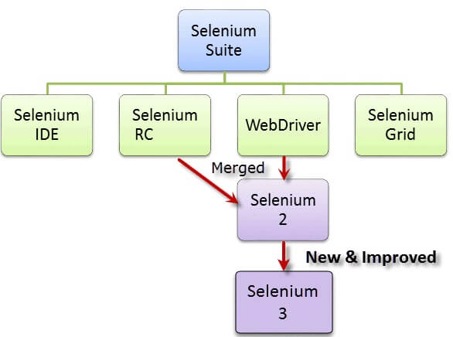
Selenium

Slide 65
Selenium
Selenium was created by Jason Huggins in 2004
He was working on a web application that required frequent testing.
He created a JavaScript program that would automatically control the browser’s actions. He named this program as the
“JavaScriptTestRunner“
He made JavaScriptRunner open-source which was later re-named as Selenium Core.

Slide 66
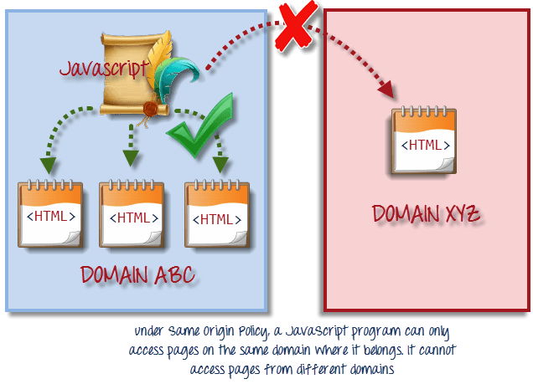
Selenium
Issue with the Selenium core
Same Origin policy prohibits JavaScript code from accessing elements from a domain that is different from where it was launched.

Slide 67
Selenium
Selenium Remote Control
Testers using Selenium Core had to install the whole application under test and the web server on their own local computers because of the restrictions imposed by the same origin policy.
Paul Hammant, decided to create a server that will act as an HTTP proxy to “trick” the browser into believing that Selenium Core and the web application being tested come from the same domain.
his system became known as the Selenium Remote Control or Selenium 1

Slide 68
Selenium
Selenium Grid
Selenium Grid was developed by Patrick Lightbod
To address the need of minimizing test execution times as much as possible.
He initially called the system “Hosted QA.”
It captures the browser screenshots during significant stages,

Slide 69
Summary
Designing test cases for black box testing:
  does not require any knowledge of how the functions have been designed and implemented.
  Test cases can be designed by examining only SRS document.

Slide 70
Summary
White box testing:
  requires knowledge about internals of the software.
  Design and code is required.

Slide 71
Summary
We have discussed a few white-box test strategies.
  Statement coverage
  branch coverage
  condition coverage
  path coverage

Slide 72
Summary
A stronger testing strategy:
  provides more number of significant test cases than a weaker one.
  Condition coverage is strongest among strategies we discussed.

Slide 73
Summary
We discussed McCabe’s Cyclomatic complexity metric:
  provides an upper bound for linearly independent paths
  correlates with understanding, testing, and debugging difficulty of a program.

